Slide 1
Streaming algorithms for fair k-means clustering Christian Sohler (joint work with Melanie Schmidt and Chris Schwiegelshohn)

Slide 2
Fairness in machine learning
Fairness
sensitive attributes (gender, race, religious orientation, etc.) should not have impact on (automatic) decisions
Fairness in machine learning?
Algorithms are unbiased
Data may still be biased and lead to biased results
Notions of fairness
Different notions of fairness exist
Might not be possible to achieve them simultanuously [Kleinberg, Mullainathan, Rashavan, 2017]

Slide 3
Today‘s notion of fairness
Sensitive attribute(s)
One sensitive attribute encoded as the color of a point (yellow, blue)
Output model should represent all groups equally
Balanced Clustering [Chiericetti, Kumar, Lattanzi, Vassilvitskii, 2017]
The number of yellow and blue points in each cluster are the same (but the number of points assigned to each cluster can differ)
Condition can be relaxed
Today‘s problem
Find an approximate solution to the balanced k-means clustering
What can we do in a streaming setting?

Slide 4
Previous results
O(1)-approximation for metric k-median via fairlets [Chiericetti, Kumar, Lattanzi, Vassilvitskii, 2017]
Idea
Compute mincost bipartite matching (the resulting pairs are the fairlets)
Pick one point from each fairlet
Run k-median algorithm on the resulting point set
Analysis
Matching-cost is at most Opt
Result follows from triangle inequality

Slide 5
Outline
Fair k-means algorithm
Fair k-means++
Fair coresets
Streaming algorithms for fair k-means
Experiments

Slide 6
Fair k-means clustering (objective)
Input: Set P of colored points in R^{d}
Output: A set of k center C={c₁,…,c_{k}} and a partition of input set P into subsets P₁,…, P_{k} such that
Σ Σ
is minimized under
|{p∈P_{i} | color(p) = yellow}| = |{p ∈P_{i} | color(p) = blue}| (balance condition)
k
||p-c_{i}||²
i=1
p∈C_{i}

Slide 7
Fair k-means clustering (objective)
Input: Set P of colored points in R^{d}
Output: A set of k center C={c₁,…,c_{k}} and a partition of input set P into subsets P₁,…, P_{k} such that
Σ Σ
is minimized under
|{p∈P_{i} | color(p) = yellow}| = |{p ∈P_{i} | color(p) = blue}| (balance condition)
For a given set C we will write cost(P,C) to be the cost of the best solution using set of centers C.
k
||p-c_{i}||²
i=1
p∈C_{i}

Slide 8
What‘s known?
[Bhattacharya, Jaiswal, Kumar, 2018]
Can compute in time O(nd 2^{O(k/ε)}) a list of 2^{O(k/ε)} sets of k-centers such that at least one of them is a (1+ε)-approximation to any constraint solution
Reduces the k-means problem to the assignment problem
~
~

Slide 9
Fair k-means algorithm
k-means algorithm (Lloyd‘s algorithm)
Start with an arbitrary set of k centers
Repeat until convergence
Assign each input point to its nearest center
Compute the optimal center for each cluster

Slide 10
Fair k-means algorithm
How to do this step?
Fair k-means algorithm (Lloyd‘s algorithm)
Start with an arbitrary set of k centers
Repeat until convergence
Assign each input point to its nearest center
Compute the optimal center for each cluster

Slide 11
Fair k-means algorithm
How to do this step?
Fair k-means algorithm (Lloyd‘s algorithm)
Start with an arbitrary set of k centers
Repeat until convergence
Assign each input point to its nearest center
Compute the optimal center for each cluster

Slide 12
Fair k-means algorithm
How to do this step?
Fair k-means algorithm (Lloyd‘s algorithm)
Start with an arbitrary set of k centers
Repeat until convergence
Assign each input point to its nearest center
Compute the optimal center for each cluster

Slide 13
Fair k-means algorithm
How to do this step?
Fair k-means algorithm (Lloyd‘s algorithm)
Start with an arbitrary set of k centers
Repeat until convergence
Assign each input point to its nearest center
Compute the optimal center for each cluster

Slide 14
Fair k-means algorithm
How to do this step?
Fair k-means algorithm (Lloyd‘s algorithm)
Start with an arbitrary set of k centers
Repeat until convergence
Assign each input point to its nearest center
Compute the optimal center for each cluster
Assignment problem reduces to mincost bipartite matching
In practice only moderately efficient

Slide 15
Fair k-means++
Fair k-means++
Compute fairlets [Chiericetti, Kumar, Lattanzi, Vassilvitskii, 2017]
Use one point from each fairlet
Run k-means++ on this input to compute set of centers C
Run fair k-means with starting centers C
Analysis
Essentially follows from relaxed triangle inequality

Slide 16
Fair coresets
Definition (classical coreset) [Har-Peled, Mazumdar, 2004]
A small weighted set S is a coreset for an input point set P, if for every set C of k centers we have
(1-ε) cost(P,C) ≤ cost(S,C) ≤ (1+ε) cost(P,C)
Composability
coreset(A) ∪ coreset(B) is a coreset for A ∪ B
Reducibility
Can compute a coreset of a coreset

Slide 17
Fair coresets
Can we use this definition for fair k-means?
Definition (classical coreset) [Har-Peled, Mazumdar, 2004]
A small weighted set S is a coreset for an input point set P, if for every set C of k centers we have
(1-ε) cost(P,C) ≤ cost(S,C) ≤ (1+ε) cost(P,C)
Composability
coreset(A) ∪ coreset(B) is a coreset for A ∪ B
Reducibility
Can compute a coreset of a coreset

Slide 18
Fair coresets
Yes, but it would not satisfy composability!
Definition (classical coreset) [Har-Peled, Mazumdar, 2004]
A small weighted set S is a coreset for an input point set P, if for every set C of k centers we have
(1-ε) cost(P,C) ≤ cost(S,C) ≤ (1+ε) cost(P,C)
Composability
coreset(A) ∪ coreset(B) is a coreset for A ∪ B
Reducibility
Can compute a coreset of a coreset

Slide 19
Coresets – why composability is violated
Dataset (k=4)

Slide 20
Coresets – why composability is violated
Subset A

Slide 21
Coresets – why composability is violated
Subset B

Slide 22
Coresets – why composability is violated
Coreset A

Slide 23
Coresets – why composability is violated
Coreset A
4
4

Slide 24
Coresets – why composability is violated
Coreset A
4
4

Slide 25
Coresets – why composability is violated
Subset B

Slide 26
Coresets – why composability is violated
Coreset B
4
4

Slide 27
Coresets – why composability is violated
Union of Coresets
4
4
4
4

Slide 28
Coresets – why composability is violated
Query set of centers

Slide 29
Coresets – why composability is violated
Query on union of Coresets
4
4
4
4

Slide 30
k-means clustering with color constraints
Input: Set P of colored points in R^{d}
Output: A set of k center C={c₁,…,c_{k}} and a partition of input set P into subsets P₁,…, P_{k} such that
Σ Σ
is miniminzed under the constraints
|{p∈P_{i} | color(p) = yellow}| = Y_{i}
|{p∈P_{i} | color(p) = blue}| = B_{i}
k
||p-c_{i}||²
i=1
p∈C_{i}

Slide 31
Fair coresets
Definition (fair coreset)
A small weighted set S is a coreset for an input point set P, if for every set C of k centers we have for every color constraint K
(1-ε) cost(P,K,C) ≤ cost(S, K, C) ≤ (1+ε) cost(P,K,C)
Fairness
Implies coreset for all balanced color constraints, i.e. fair k-means
Composability
Yes, since every solution for A∪B can be split into color constraint solutions for A and B

Slide 32
Do fair coresets exist?
Corollary from [Har-Peled, Mazumdar, 2004]
There is a coreset for fair k-means clustering of size O_{d}(k log n / ε^{d}). This implies a streaming algorithm for low dimensional spaces, i.e. constant d.
Sketch of proof:
Moving the points by an overall l₂² distance of O(ε² Opt) changes the cost of any solution by at most a factor of (1±ε)
The construction of Har-Peled and Mazumdar is based on the above argument
The streaming algorithm follows using the merge&reduce technique

Slide 33
High dimensional streams
Idea
Use cost-preserving sketch by Cohen et al. to reduce dimension to O(k/ε²)
Problem: Projects to random subspace and does not preserve geometry
Solution: Maintain for each coreset point the linear sum of its corresponding points in the original space
Essentially replaces d in previous construction by O(k/ε²)
Corollary
There is a streaming algorithm that uses space O(d log^{O(1)} n) for constants k and ε.
Open Problem
Get space poly(d, log n, k, ε)

Slide 34
Experiments
Coreset Algorithm
Modification of BICO [Fichtenberger et al. , 2013]
BICO uses „movement-based“ coresets, i.e. will still work for fair k-means
Fair k-means algorithms
k-means++ on fairlets: Compute fairlets and run k-means++ on colorless data
Fair k-means++: Run k-means++ seeding on fairlets and then invoke fair k-means

Slide 35
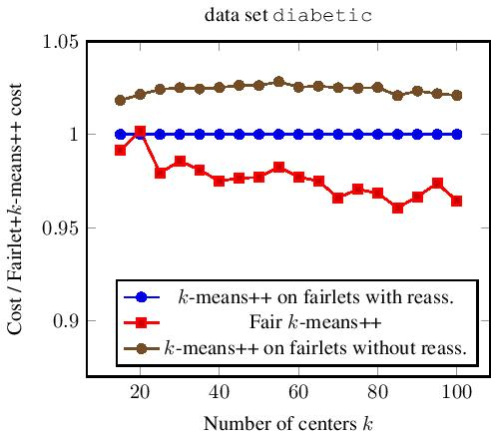
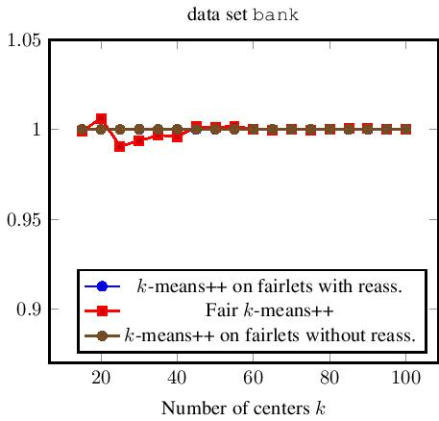
Experiments
k-means++ on fairlets vs fair k-means++

Slide 36
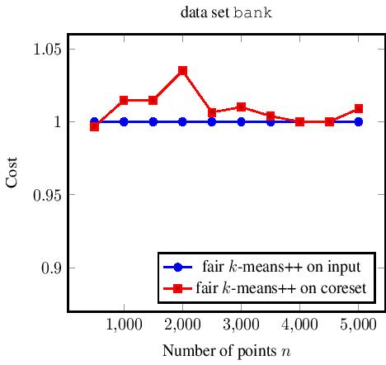
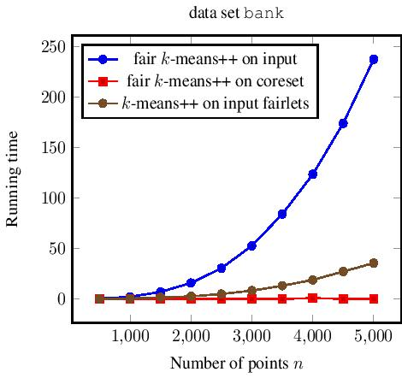
Experiments
Coresets to speed up fair k-means++

Slide 37
Conclusion
Streaming fair k-means
Require that clusters are balanced wrt. sensitive attribute
k-means and k-means++ can be easily translated, but are significantly slower
Coresets should be defined wrt. every possible color constraint
Existence of coresets follows similarly to previous work
For high-dimensional streams we present new combination of cost-preserving sketches and coresets
Experiments show that coresets help significantly while the quality of the solution remains very good

Slide 38
Thank you!

